Slide 1

Effects of Social Media
By Marcio Ariani Feitosa

Slide 2
What is Social Media
Some of the popular Social Media
Statistics of some popular Social Media
Some Facts and Curiosities
Negative Effects
Positive Effects
References

Slide 3
What is Social Media
Social Media refers to interaction among people in which they create, share, and Exchange Information and ideas in virtual communities and networks.
Notes:
So, social media can be defined as Forms of electronic communication, such as web Sites, through which people create online communities to share Information, ideas, personal messages, etc.

Slide 4

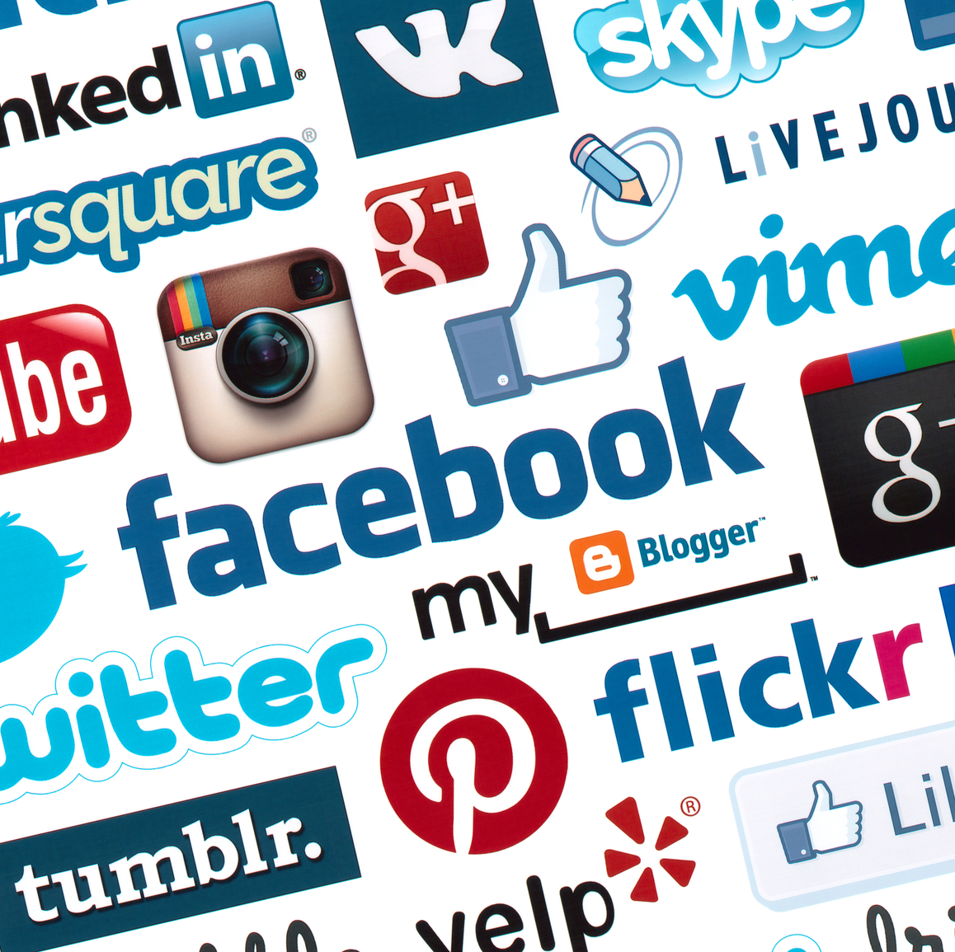

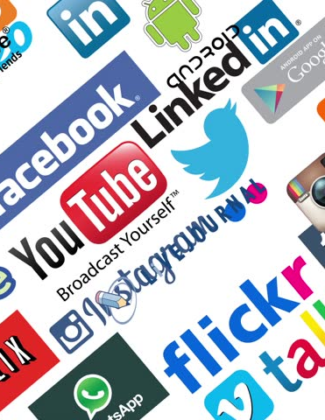
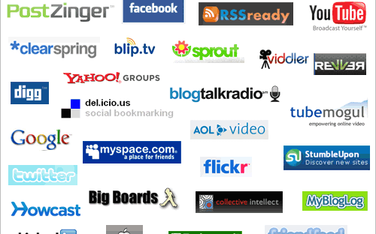
Some of the popular Social Media
Notes:
So, these are some of the popular social media we use at least once in our life. One of them we use everyday, and others we use sometimes every minute.

Slide 5
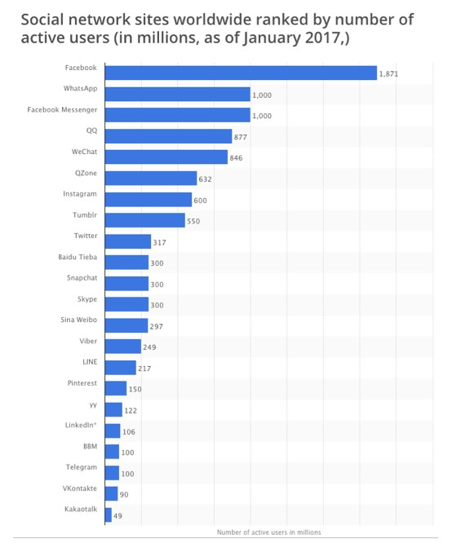
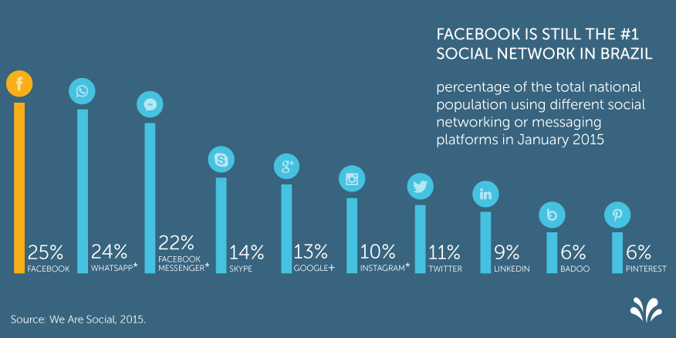
Statistics of some popular
Social Media

Slide 6
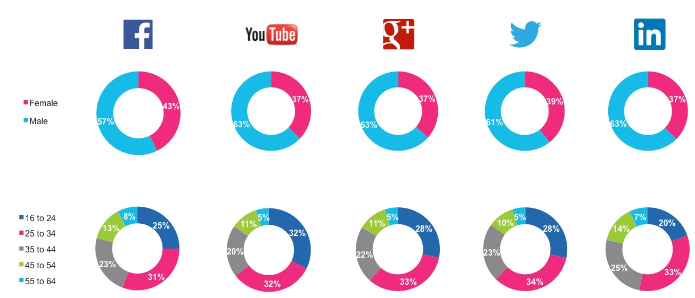
Statistics of some popular Social Media

Slide 7
Some Facts and Curiosities
23% of Facebook users check their account at least 5 times a day
Mothers with children under the age of 5 are the most active on social media
On Facebook, 250 Billion photos are uploaded every day
Anderson Cerqueira and Janete dos Santos, decided to pay homage as their preferred social networks. The first son of the couple put the name of Facebookson, the second son they put the name of Instagramilson. And if they have a third child, they will put the name of Twitterson
40% of people spend more time socializing on social media than they do in person
Notes:
The last one is true, and we see this case almost everywhere. When we go to a restaurant, to a birthday party or a simple meeting with some friends, we spend more time on a smartphone talking and doing things on a social media than interacting with someone who is in front of you.

Slide 8

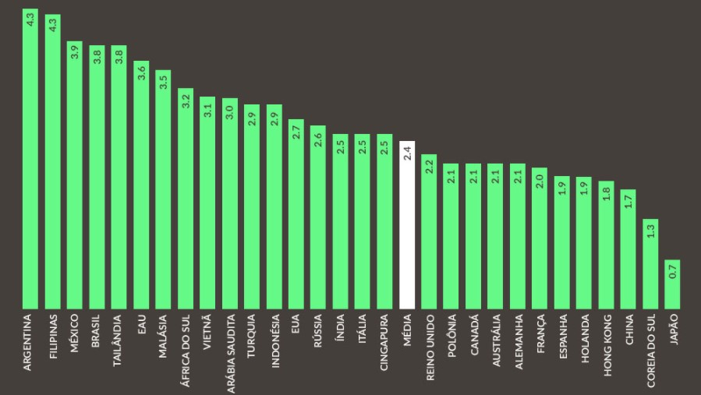
Some Facts and Curiosities
Notes:
Brazilian people spent 3,8 hours per day with social medias.

Slide 9
Negative Effects
Cyberbullying
Ruin Relationships
Waste of Time
Notes:
Cyberbullying is a serious problem that we have today. Sometimes is hard to fix when a cyberbullying is done, but we can avoid these things with social programs.
Ruin Relationships, Some people may get jealous if they find out the person who cares is exchanging messages with other people, or giving like, or commenting a friend’s photo.
Waste of time, we spend a lot of time checking the other’s life. I have a friend, that recently he deleted his Facebook, Instagram, Twitter, Tinder account, because he noticed that he was wasting a lot of time seeing what the others were doing. Now he is finishing his TCC, and he was hired from a technology company from Campo Grande.
Of course, probably there are a lot of problems, not just these one, but i think these are the most common problems we have.

Slide 10
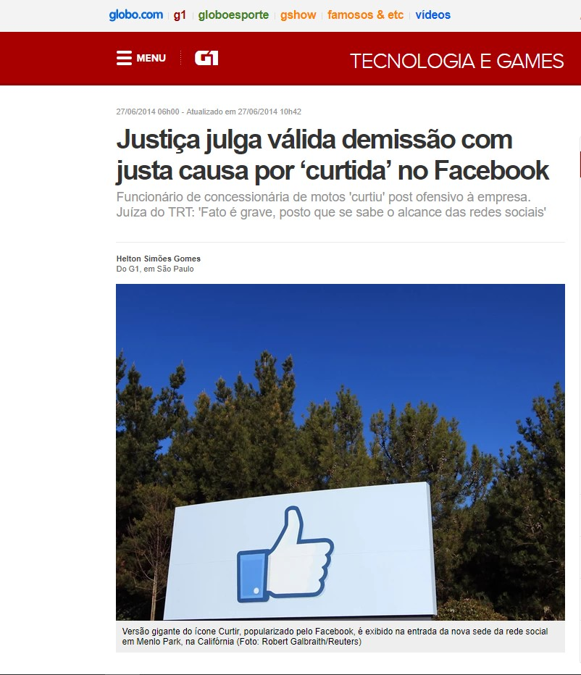
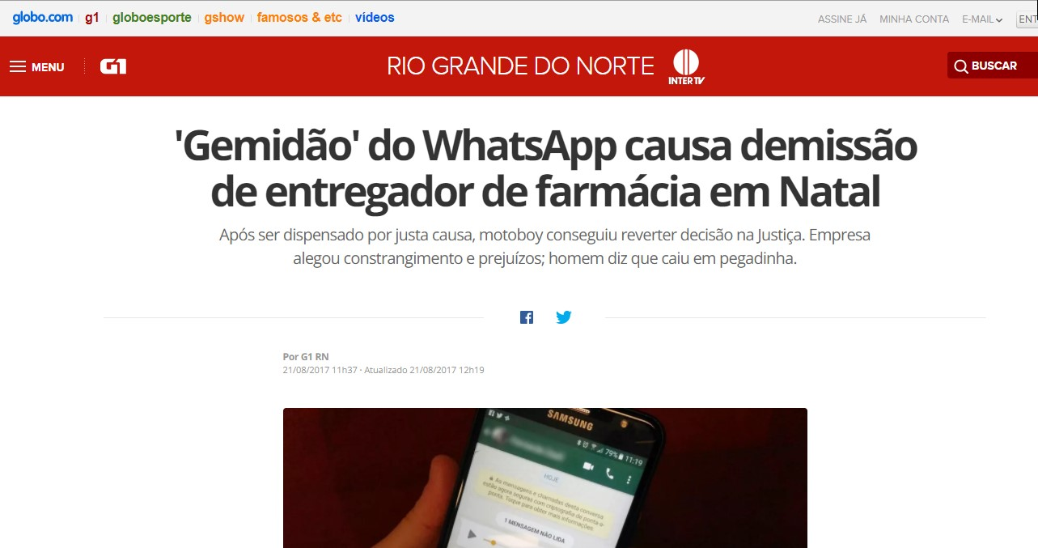
Negative Effects
Notes:
In the first case, an employee was fired because he liked on Facebook some comments offensive to the company in which he Works, worked now, and one the company’s partners. This happened in 2012.
The second case, a deliveryman was fired because he received a video on Whatsapp, and that vídeo was the famous Gemidão do Whatsapp. He watched the vídeo inside the drugstore while still having some clients. 2017

Slide 11
Positive Effects
Keep in touch with family and friends
Opportunities for Businesses
Education
Notes:
Keep in touch with Family and friends, with social media we can keep in touch with Family and friends, especially if they live far away. And we can also make new friends, sometimes friends that we might not know. (Job opportunities)
Opportunities for Businesses, today businesses have noticed the real value of social medias in our life, and they using differents techniques to promote their products. And not just this, we also have many opportunities to get a job on social medias, like LinkedIn.
Today, with the Social media students and teachers can have a lot of benefits through some social medias. With the help of vídeos, posts, discussions (good of course), and some educational platform. You also, can follow anyone to learn from him or her and improve your knowledge about any field. Regardless of your location and training, you can educate yourself without paying for it.

Slide 12
References
Chaffey, Dave. Global social media research summary 2017
2017 Disponível em: https://www.smartinsights.com/social-media-marketing/social-media-strategy/new-global-social-media-research/ - Acessado em 22/11/2017
Thomas D. Mayfield III, A Commander's Strategy for Social Media 2011 Disponível em: http://www.au.af.mil/au/awc/awcgate/jfq/mayfield_strat_for_soc_media.pdf - Acessado em 22/11/2017
Justiça julga válida demissão com justa causa por ‘curtida’ no Facebook – Disponível em: http://g1.globo.com/tecnologia/noticia/2014/06/justica-julga-valida-demissao-com-justa-causa-por-curtida-no-facebook.html - Acessado em 23/11/2017
‘Gemidão’ do WhatsApp causa demissão de entregador de farmácia em Natal – Disponível em: https://g1.globo.com/rn/rio-grande-do-norte/noticia/gemidao-do-whatsapp-causa-demissao-de-entregador-de-farmacia-em-natal.ghtml - Acessado em 23/11/2017

Slide 13
  Thanks!

